Slide 1
Applied Data Science with R Capstone project
Michael Reluzco
6/10/2024

Slide 2

Outline
Executive Summary
Introduction
Methodology
Results
Conclusion
Appendix

Slide 3

Executive Summary
This presentation aims to explore data from bike-sharing systems alongside weather data to predict strain on the bike sharing systems.
There are several factors that determine high usage in bike-sharing systems, including:
Season
Temperature
Humidity
Understanding this data would allow bike-sharing systems to transfer bikes from a city with low predicted demand to cities with high predicted demand as needed.

Slide 4

Introduction
This analysis is a series of comparisons between certain weather patterns and trends in bike-sharing usage.
During times when some cities’ bike-sharing system has a lower demand, some cities don’t have enough bikes to meet their demand.
This could be alleviated by predicting when a given city has a particularly high or low demand for shared bikes.
The questions for this analysis are as follows:
Is there a correlation between the weather in a city and the bike-sharing demand of the city?
If so, what are the weather factors that determine high and low demand for bikes in a city.

Slide 5

Methodology
Perform data collection
Perform data wrangling
Perform exploratory data analysis (EDA) using SQL and visualization
Perform predictive analysis using regression models
How to build the baseline model
How to improve the baseline model
Build a R Shiny dashboard app

Slide 6
Methodology

Slide 7
Data collection
Data on bike sharing systems was scraped from data on Wikipedia, which was aggregated from the websites of those bike sharing systems.
Data on weather was obtained through the OpenWeather API.
OpenWeather API
Raw Dataset
Wikipedia
API Interface
Web Scraping

Slide 8
Data wrangling
Data sets were processed using regular expressions to remove annotations and classify numerical data as numeric type.
Categorical Columns were converted into dummy columns to better use the data for statistical processing
Categorical Data
Dummy Columns
Wrangled Data
Annotated Numerical Data
Regular Expressions

Slide 9
EDA with SQL
Data was explored using several SQL queries to determine the following:
The number of records in the dataset
The number of records with non-zero bike rental values
The date range of the dataset
The hour and date of the highest rented bike count.
The average hourly temperature, and average number of bike rentals per hour.
The average hourly bike count during each season.
The average values of other variables in the table
The total bike count and city info for Seoul
The cities with comparable bike scale to Seoul’s bike sharing system.

Slide 10
EDA with data visualization
Several charts were made to explore relationships in the data:
Scatter plot of Rented Bike Count vs. Date
Scatter plot of Rented Bike Count vs. Date vs. Hours
Histogram of density of Rented Bike Count, with overlaid kernel density curve
Scatter plot to visualize the correlation between Rented Bike Count and Temperature by Seasons
Box Plot of Rented Bike Count vs. Hour grouped by Seasons

Slide 11
Predictive analysis
A predictive model was built by
Splitting the data into training and testing sets.
Building several linear regression models with different parameters.
Using the R-Squared and RMSE values to evaluate the better models.
Training Data
Trained Models
Model Training
Wrangled Data
Model Testing
Tested Models
Final Model
Training Split
Model Evaluation
Testing Data

Slide 12
Build a R Shiny dashboard
A Shiny dashboard was created with the following features:
A drop-down menu to select which city to display data for
A map to show the selected city
A chart displaying the temperature trend for the next five days
A chart displaying the predicted bike-sharing demand over the next five days
Each point on this chart may be clicked to show further details
A plot displaying the humidity as compared to the bike prediction data

Slide 13
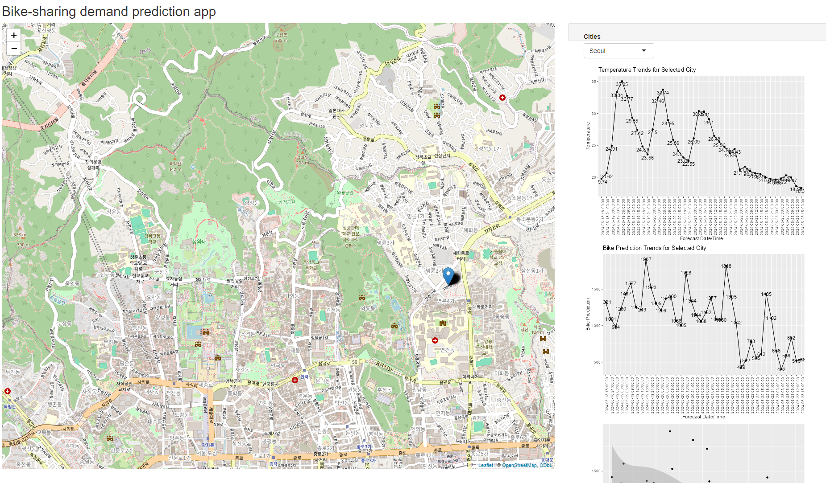
Results
Exploratory data analysis results
Bike-share demand seems to be highly influenced by weather factors
High impact weather factors include temperature and humidity
Predictive analysis results
Using only weather factors in predictive analysis yielded poorer results than using all factors
Dashboard View:

Slide 14
EDA with SQL

Slide 15
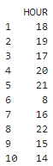
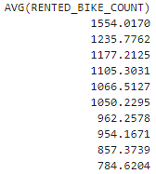
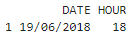
Busiest bike rental times
The above date and hour had the most bike rentals in the dataset. The following table shows the most popular hours for bike rental.

Slide 16
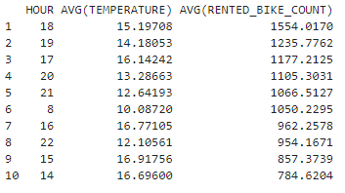
Hourly popularity and temperature by seasons
Shown above is the average temperature and average rented bike count ordered by hour.

Slide 17
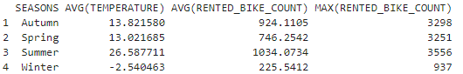
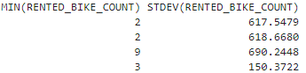
Rental Seasonality
Shown above are statistics on the rented bike count, grouped by season.

Slide 18
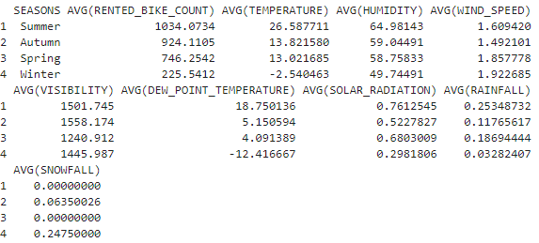
Weather Seasonality
The table above displays the average of all weather factors per season next to the average rented bike count for each season.

Slide 19
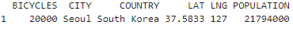
Bike-sharing info in Seoul
The above data shows statistics for the city of Seoul, along with their total number of rental bikes.

Slide 20
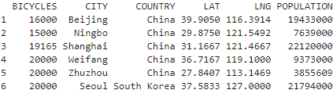
Cities similar to Seoul
Above are statistics on all cities with a similar scale rental bike system as Seoul

Slide 21
EDA with Visualization

Slide 22
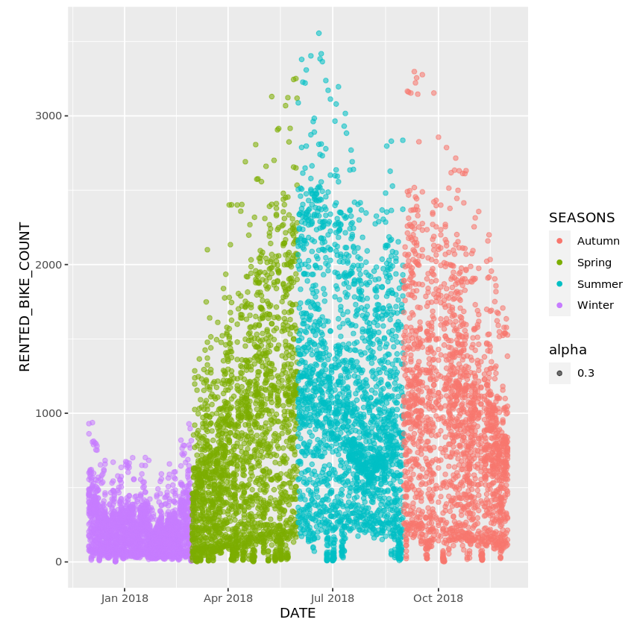
Bike rental vs. Date
This scatterplot represents the number of rented bikes across the different seasons, with each color representing a season. Note here that Spring, Summer, and Autumn have significantly higher counts than winter, all seasons with typically higher temperature and humidity.

Slide 23
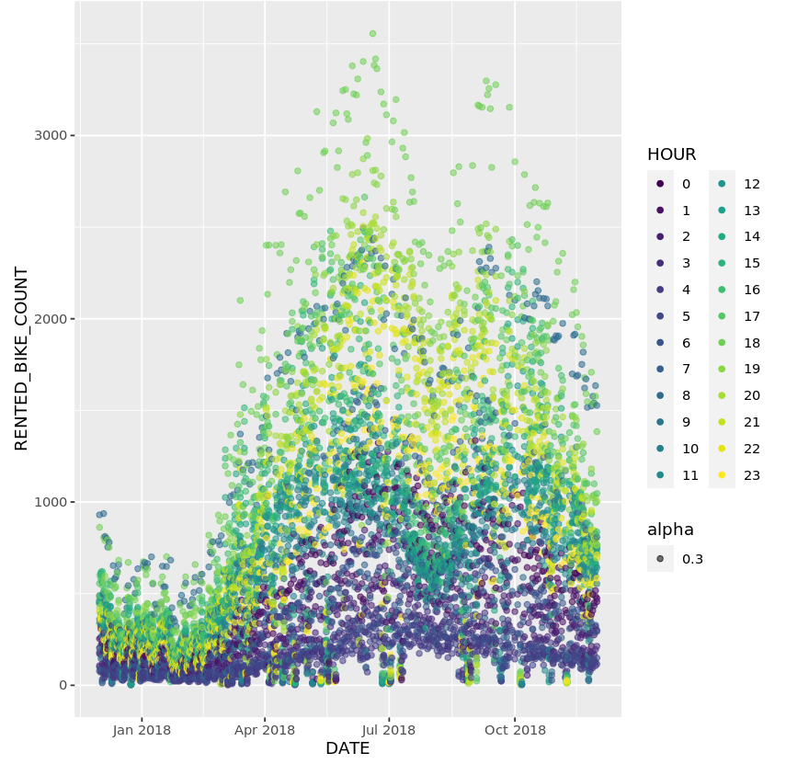
Bike rental vs. Datetime
This scatterplot is the same as a previous one, but color coded by time. Looking near the top and bottom, the colors seem to group together in bands, specifically with hours 1-7 being low demand, and hours 18-23 being high demand.

Slide 24
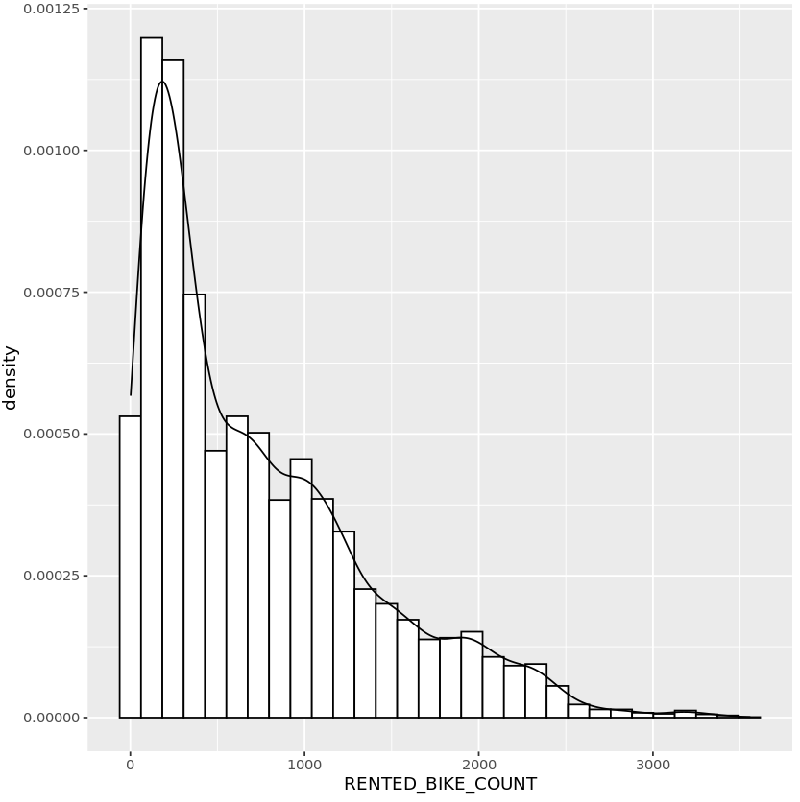
Bike rental histogram
The x axis in this chart represents the density of the total number of rented bikes at any given time. For example, this chart shows that at most times, about 200-300 bikes are being rented at any given time. Higher rental rates drop off dramatically from there.

Slide 25
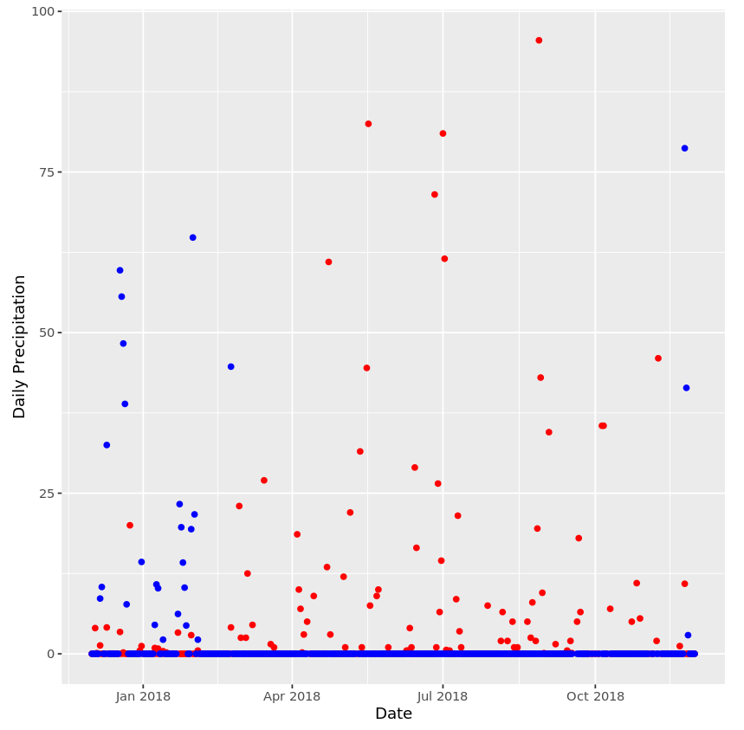
Daily total rainfall and snowfall
This chart displays total precipitation throughout the year, with red dots representing days with rain, and blue dots representing days with snow.

Slide 26
Predictive analysis

Slide 27
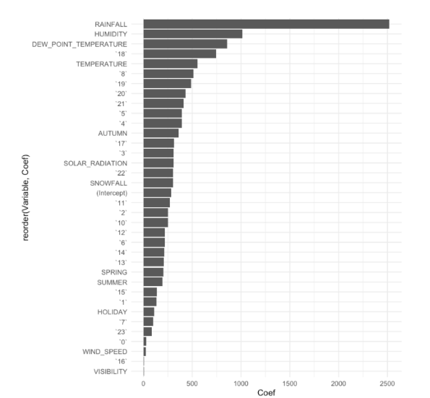
Ranked coefficients
This is a ranked list of the coefficients with highest influence on the created statistical model. Rainfall and Humidity both seem to play a strong role in determining how many bikes are rented.
This makes sense, as you can expect biking in the rain or high humidity to be unpleasant, thus driving consumers to alternative modes of transit.

Slide 28
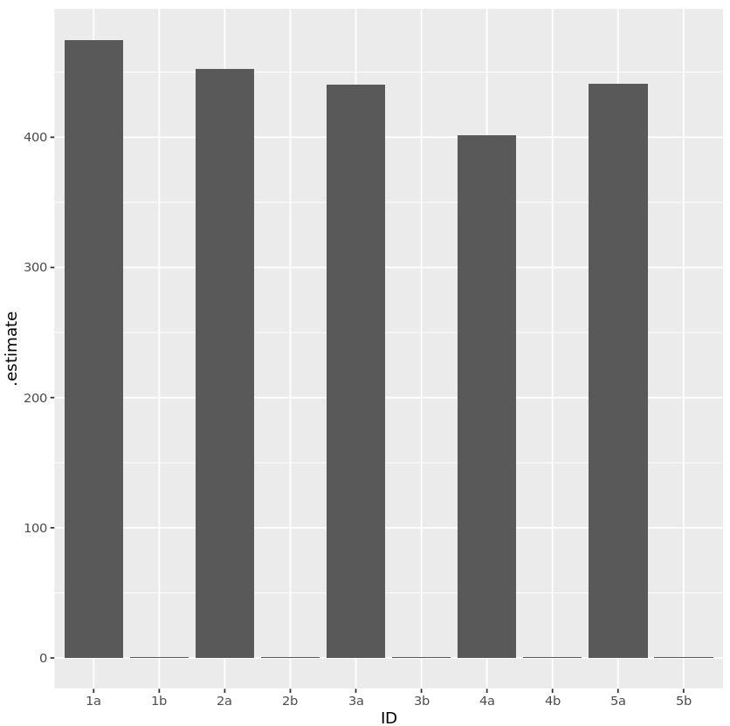
Model evaluation
Of the 5 different models built, model 4 has the lowest RMSE value and the highest R-Squared value.

Slide 29
Find the best performing model
Select the best performing model with:
RMSE must be less than 330
R-squared must be larger than 0.72
Shown a screenshot of the model performance
Show its model formula here (RENTED_BIKE_COUNT ~ x1 + x2 + x3 ….)
You could optionally present their final coefficients here

Slide 30
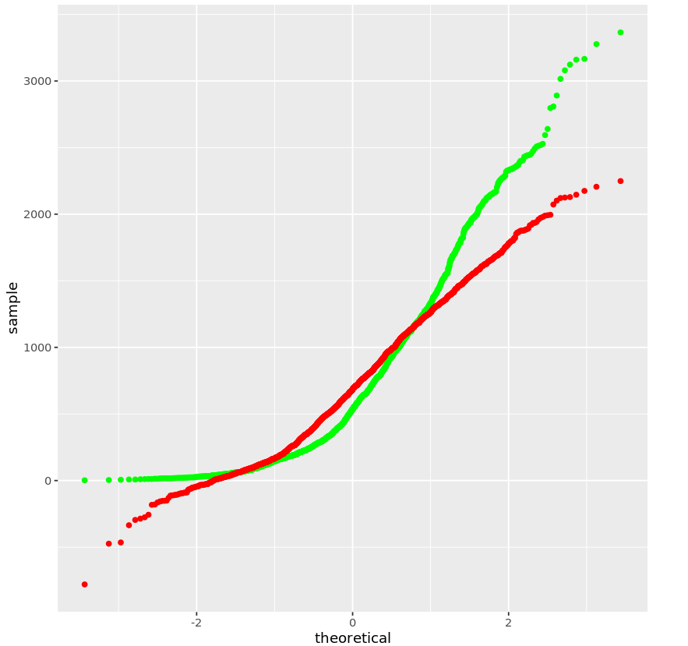
Q-Q plot of the best model
In this Q-Q plot, green represents the true count of rented bikes, and red represents the model’s predictions.

Slide 31
Dashboard

Slide 32
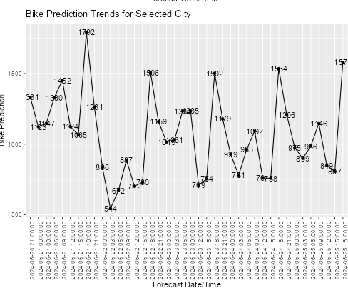
Max Bike Prediction for Seoul
This chart shows the maximum bike prediction for Seoul over the coming days.
Note that it spikes between 15:00 and 18:00 each day, as expected from previous data.

Slide 33
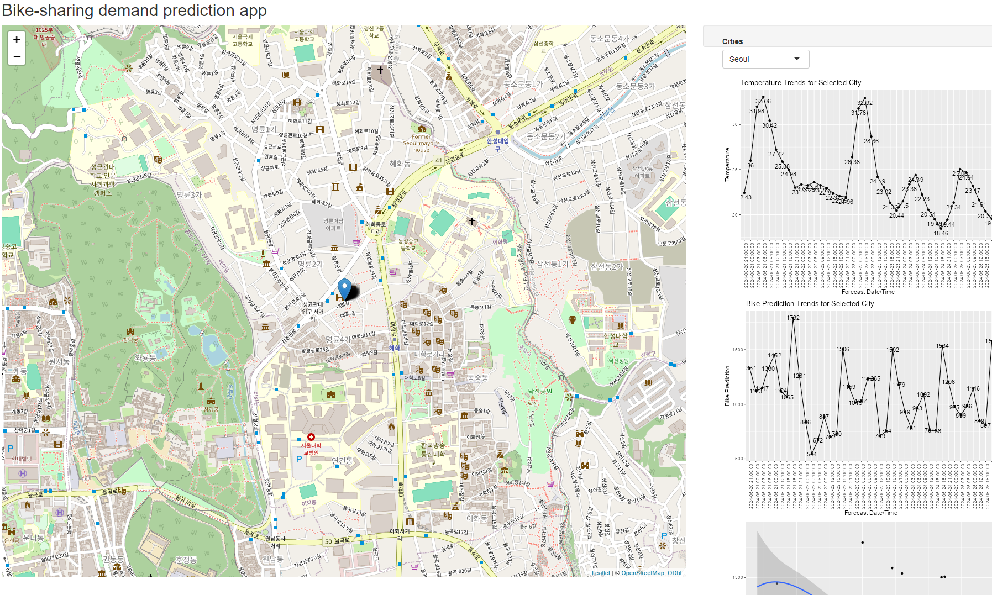
Snapshot of Trends vs. Temperature
Note here how, as temperature spikes, the model reacts, predicting less rented bike count.

Slide 34
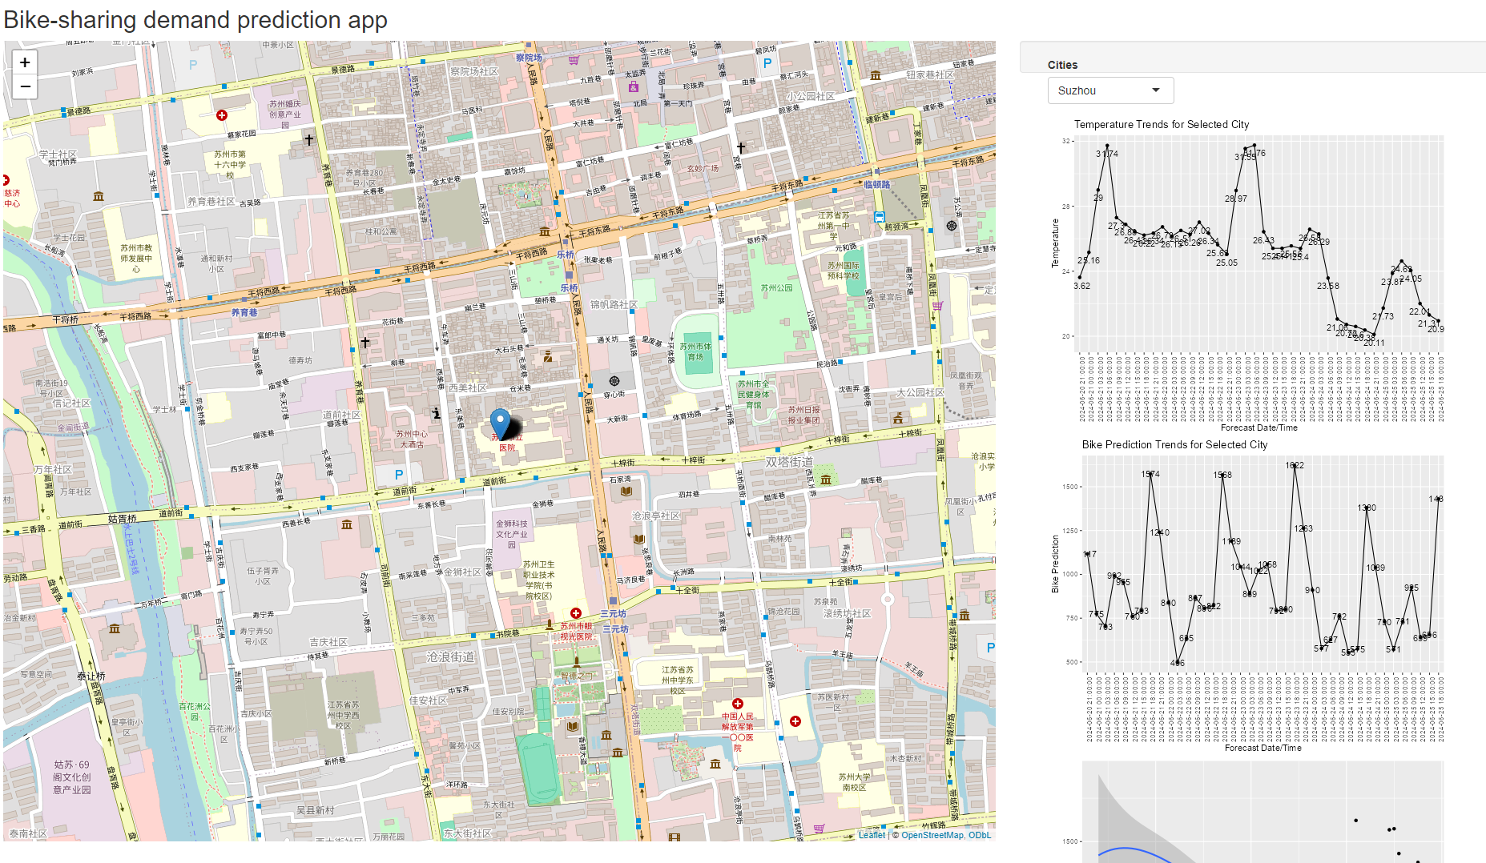
Model Performance on other Cities
Here you can see that the model performs similarly with every city.

Slide 35

CONCLUSION
Rates of Bike Rentals are heavily dependent on weather and season.
Rates of Bike Rentals are also heavily dependent on time of day.
Based on these, the rate of bike rentals can be modelled accurately.
Weather trends can be used to forecast high demands in bike rentals, and to shift supply between cities to meet demand.

Slide 36

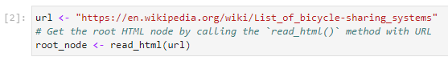
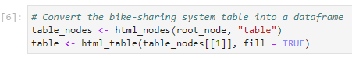
APPENDIX
Data Gathering: Web Scraping

Slide 37
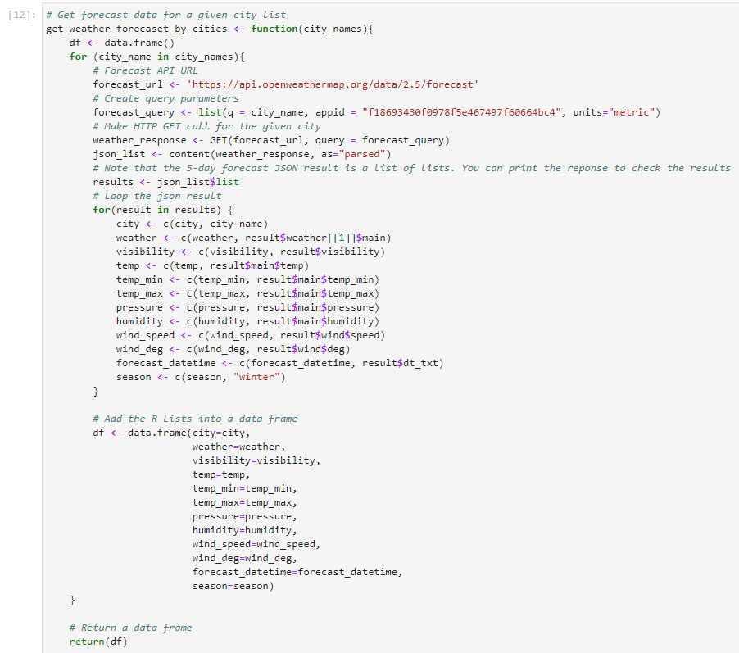
APPENDIX
Data Gathering: OpenWeather API

Slide 38
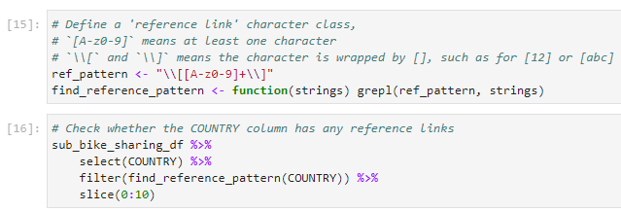
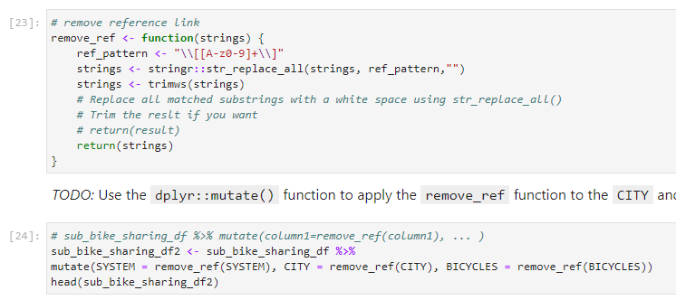
APPENDIX
Data Wrangling with Regular Expressions:

Slide 39
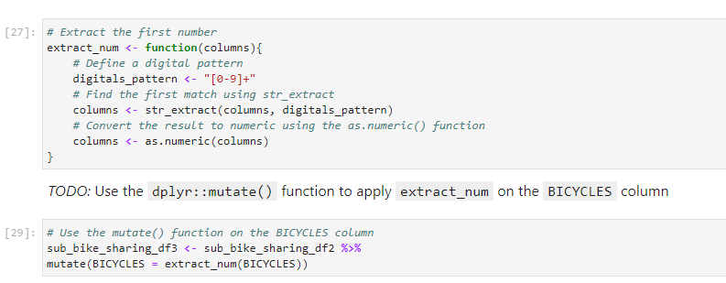
APPENDIX
Data Wrangling with Regular Expressions:

Slide 40
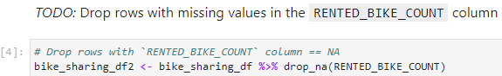
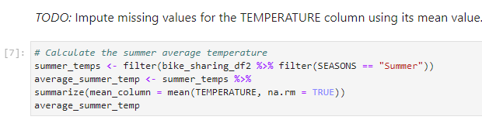
APPENDIX
Data Wrangling with dplyr (Missing Values):

Slide 41
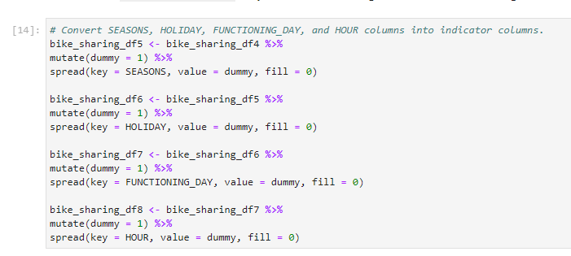
APPENDIX
Data Wrangling with dplyr (Dummy Columns):

Slide 42
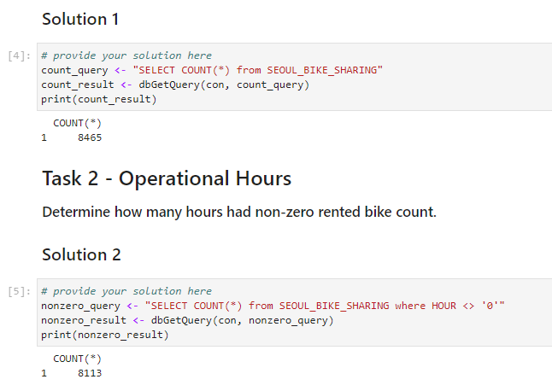
APPENDIX
EDA with SQL:

Slide 43
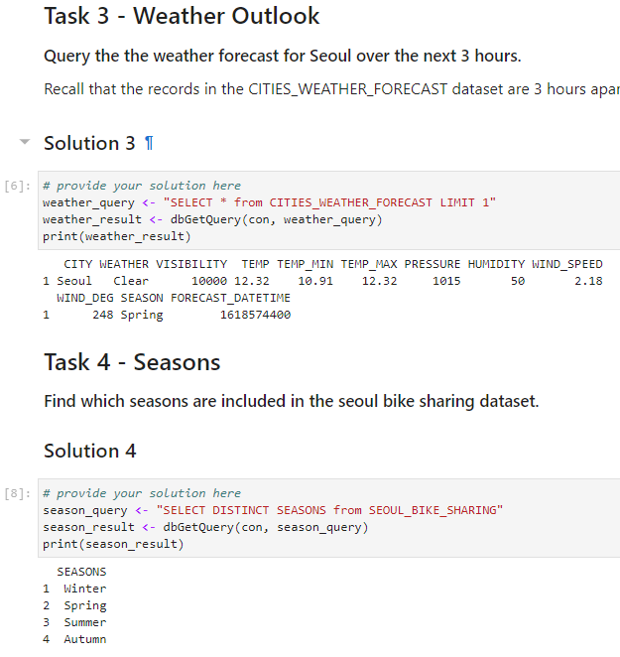
APPENDIX
EDA with SQL:

Slide 44
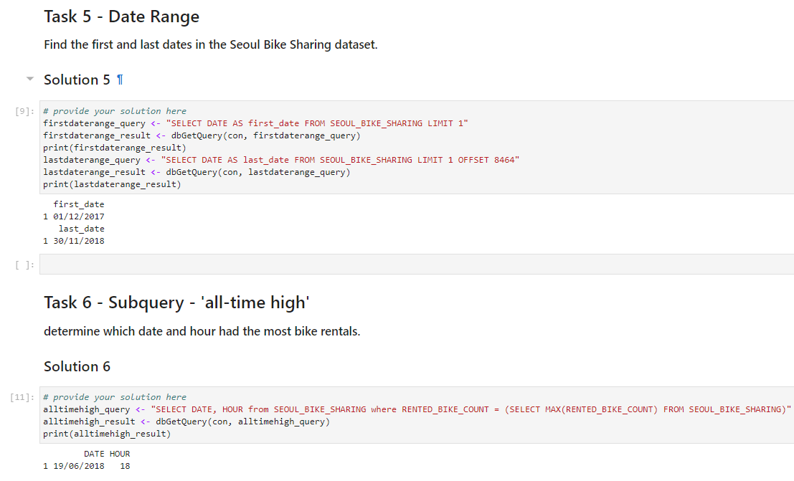
APPENDIX
EDA with SQL:

Slide 45
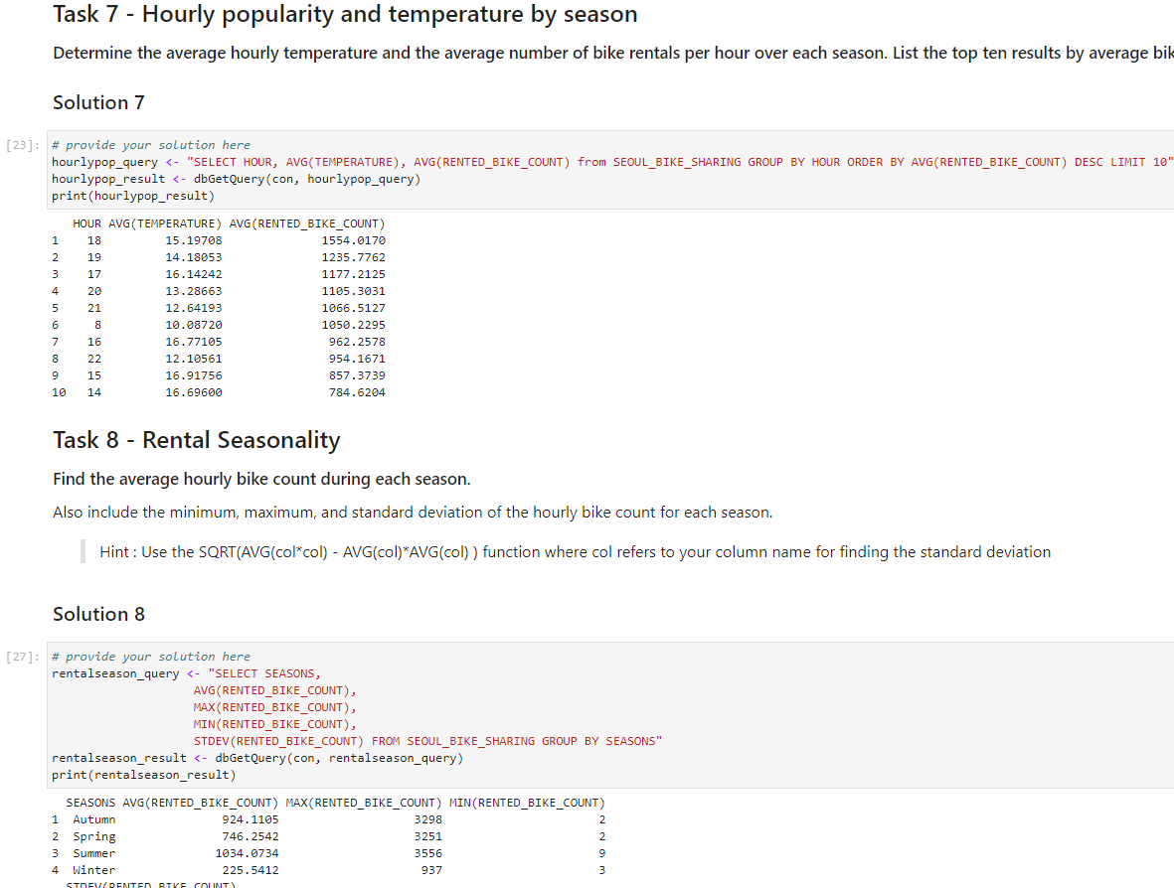
APPENDIX
EDA with SQL:

Slide 46
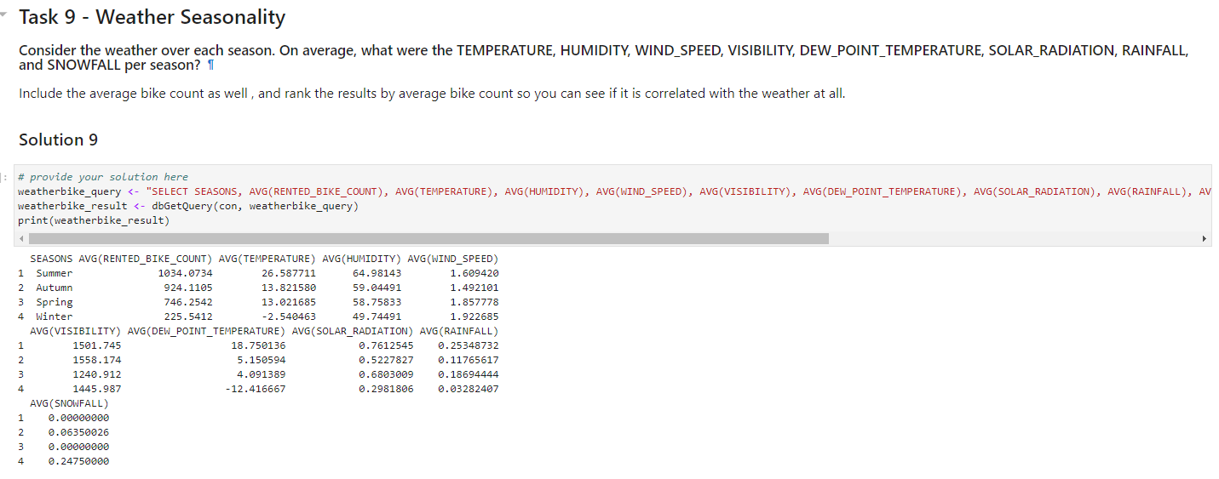
APPENDIX
EDA with SQL:

Slide 47
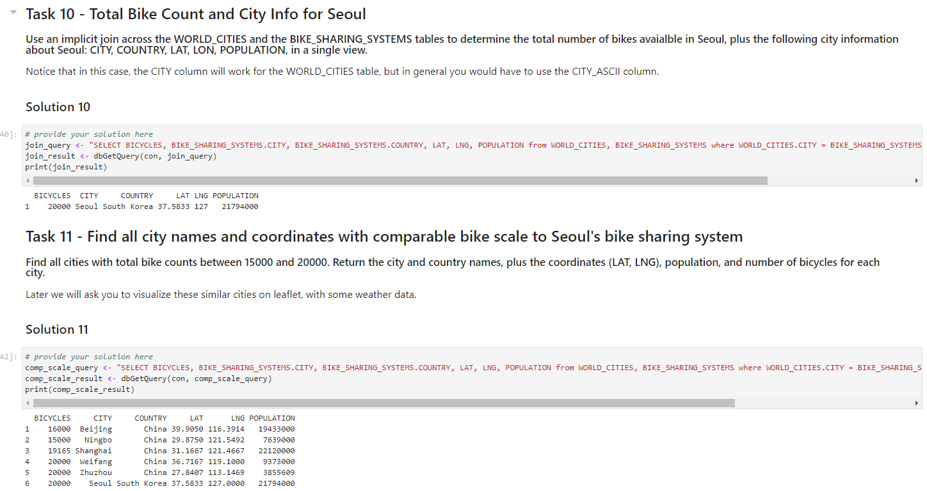
APPENDIX
EDA with SQL:

Slide 48
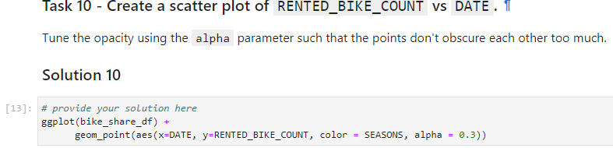
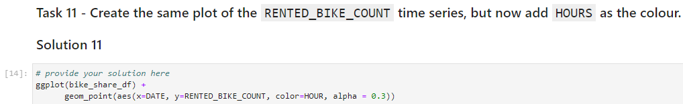
APPENDIX
EDA with Visualizations:

Slide 49
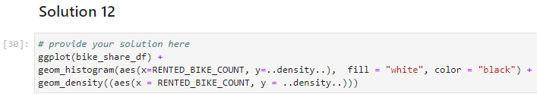
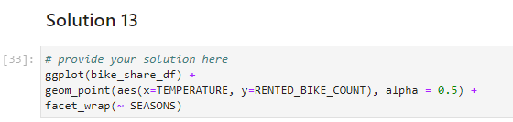
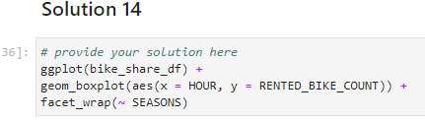
APPENDIX
EDA with Visualizations:

